Slide 1
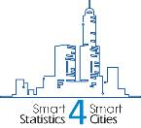
Standards for Smart and Sustainable Cities
Saturday, 6th October 2018
Prof. Panos Fitsilis, Univ. of Applied Sciences of Thessaly
Member of working group for «Smart and Viable Cities», ELOT
SmartStatistics4SmartCities

Slide 2
Defining a smart city
Smart city is an ecosystem
Offers a variety of services to citizens
Ensure information exchange between subsystems
Enables analysis of information, creation of statistics for optimizing resource utilization
SmartStatistics4SmartCities

Slide 3
Defining a Sustainable Smart City (SSC)
A Smart Sustainable City (SSC) is an innovative city that uses information and communication technologies (ICTs) and other means to improve quality of life, efficiency of urban operation and services, and competitiveness, while ensuring that it meets the needs of present and future generations with respect to economic, social and environmental aspects.
ITU-T Focus Group on Smart Sustainable Cities
SmartStatistics4SmartCities

Slide 4
Key themes of SSC
ITU-T Focus Group on Smart Sustainable Cities
SmartStatistics4SmartCities
Notes:
ICT/Communication/Intelligence/Information
Information and communication technology (ICT) provides services such as security, health care, and transport for citizens, improved and cost effective power supply for industries, remote working and e-commerce for businesses, as well as entertainment and communications for individuals
Infrastructure
Infrastructure includes the basic physical and organizational structures necessary for the operations of society/enterprises and the services/facilities that keep the economy functional.
Environment/Sustainability
As defined by the IUCN, UNEP and WWF: "sustainability is improving the quality of human life while living within the carrying capacity of supporting eco-systems“ The World Commission on Environment and Development8 (also known as the Brundtland Commission) defines sustainable development as a form of development which "meets the needs of the present without compromising the ability of future generations to meet their own needs".
People/Citizens/Society
The differentiating element between a digital city and a smart city is smart people. Key elements include skills, education level, life-long learning, and social integration in terms of human capital.
Quality of life/Lifestyle
The World Health Organization (WHO) defines quality of life as "individuals' perception of their position in life in the context of the culture and value systems". These include their location in relation to goals, expectations, and concerns
Governance/Management/Administration
Smart governance includes political and active participation, citizenship services and the smart use of e-government.
Economy/Resources
Successful elements of the enterprise economy and the innovation/ideas economy are combined to form the smart economy. It also provides for a high-quality environment that focuses on the bettering of energy security and social cohesion.
Mobility
Smart mobility moves people and freight while enhancing economic, environmental, and human resources by emphasizing convenient and accessible multimodal travel (ensuring safety and operating at suitable speeds).
4 ICT behind cities of the future. Nokia. Retrieved 29th June 2014 from http://nsn.com/news-events/publications/unite-magazine-february-2010/the-ict-behind-cities-of-the-future
5 Oxford Dictionaries. Retrieved 1st June 2014 from http://www.askoxford.com/concise_oed/infrastructure
6 Sullivan, Arthur, Steven M. Sheffrin (2003), Economics: Principles in action. Upper Saddle River, New Jersey 07458: Pearson Prentice Hall. p. 474.
7 IUCN/UNEP/WWF. Caring for the Earth: A Strategy for Sustainable Living. (Gland, Switzerland: 1991). (IUCN – The International Union for Conservation of Nature, UNEP – United Nations Environment Programme, WWF – World Wide Fund for Nature).
8 UN Documents Gathering a body of global agreements. NGO Committee on Education. Retrieved 2nd June from< http://www.un-documents.net/wced-ocf.htm >
9 Toolkit on Environmental Sustainability for the ICT Sector. International Telecommunication Union. Retrieved from http://www.itu.int/dms_pub/itu-t/oth/4B/01/T4B010000060001PDFE.pdf. 2012
10 SMART CITIES STUDY: International study on the Situation of ICT, Innovation and Knowledge in cities. Iñaki Azkuna, Mayor of the City of Bilbao. Retrieved from http://www.cities-localgovernments.org/committees/cdc/Upload/formations/smartcitiesstudy_en.pdf
11 Programme on Mental Health: Measuring Quality of Life. Division of Mental Health and Prevention of Substance Abuse. World Health Organization. 1997. Retrieved from http://www.who.int/mental_health/media/68.pdf.
12 http://www.cities-localgovernments.org/committees/cdc/index.asp?IdPage=62
13 Building Ireland's Smart Economy – Government of Ireland 2008 Report Retrieved from http://www.taoiseach.gov.ie/eng/Building_Ireland's_Smart_Economy/Building_Ireland's_Smart_Economy_-_Executive_Summary.pdf
14 Smart City Mobility: a call to action for the new decade. United States Environmental Protection Agency. February 2010. Retrieved from http://www.dot.ca.gov/hq/tpp/offices/ocp/smf_files/SMF_handbook_062210.pdf.

Slide 5
Key priorities identified with standards strategy
How will City Authorities set their objectives for Sustainable Smart Cities and measure progress?
How can cities create the shared understanding to deliver the vision?
How will information be captured and shared between infrastructure and services?
SmartStatistics4SmartCities

Slide 6
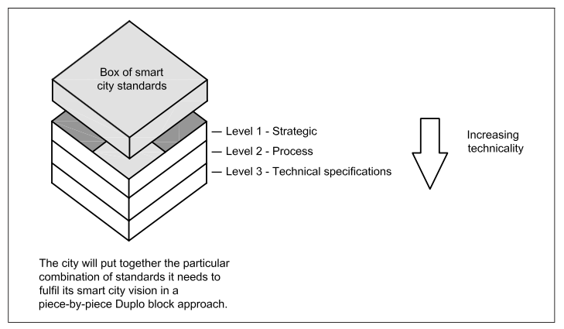
Need of standards at various levels
SmartStatistics4SmartCities
BSI, 2015
Notes:
Level 1: Strategic: These are smart city standards that aim to provide guidance to city leadership and other bodies on the “process of developing a clear and effective overall smart city strategy”. They include guidance in identifying priorities, how to develop a roadmap for 3implementation and how to effectively monitor and evaluate progress along the roadmap.
Level 2: Process: Standards in this category are focused on procuring and managing smart city projects – in particular those that cross both organizations and sectors. These essentially offer best practices and associated guidelines.
Level 3: Technical: This level covers the myriad technical specifications that are needed to actually implement Smart City products and services so that they meet the overall objectives

Slide 7
International standardrization organizations
European bodies
CEN - European Committee for Standardization (CEN),
CENELEC - European Committee for Electrotechnical Standardization
ETSI - European Telecommunications Standards Institute
ISO: International Organization for Standards . The main global body that national standards bodies work with and with which many of us are familiar with via “ISO certified”
ITU: ITU is the United Nations specialized agency for information and communication technologies – ICTs
IEC: Founded in 1906, the IEC (International Electrotechnical Commission) is the world’s leading organization for the preparation and publication of International Standards for all electrical, electronic and related technologies. These are known collectively as “electrotechnology”.
SmartStatistics4SmartCities

Slide 8
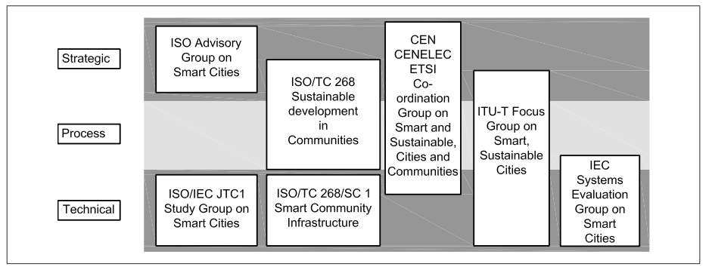
Standarization activities at international level
SmartStatistics4SmartCities

Slide 9
Major standards at strategic level
ISO 37101: Sustainable development & resilience of communities – Management systems – General principles & requirements
ISO 37120 Sustainable development of communities — Indicators for city services and quality of life.
ISO 37102: Sustainable development & resilience of communities – Vocabulary.
ISO 37123: Indicators for resilient cities (under development)
ELOT 1457 standard (Greek)
BS 8904 has a focus on sustainable communities and “provides a framework as recommendations and guidance that assist communities to improve.
SmartStatistics4SmartCities

Slide 10
Standards for process – Procuring and managing smart city projects
Smart city framework standard (PAS 181). It provides practical, ‘how-to’ advice, reflecting current good practice as identified by a broad range of public, private and voluntary sector practitioners engaged in facilitating UK smart cities
Data concept model for smart cities (PAS 182).
SmartStatistics4SmartCities

Slide 11
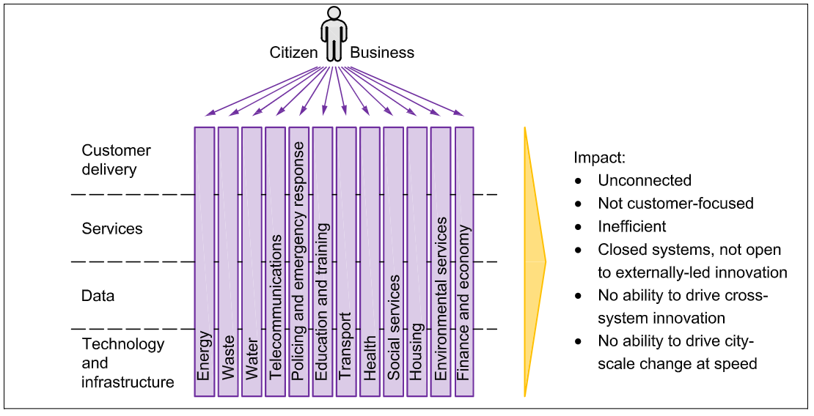
PAS 181 – Transforming smart cities from

Slide 12
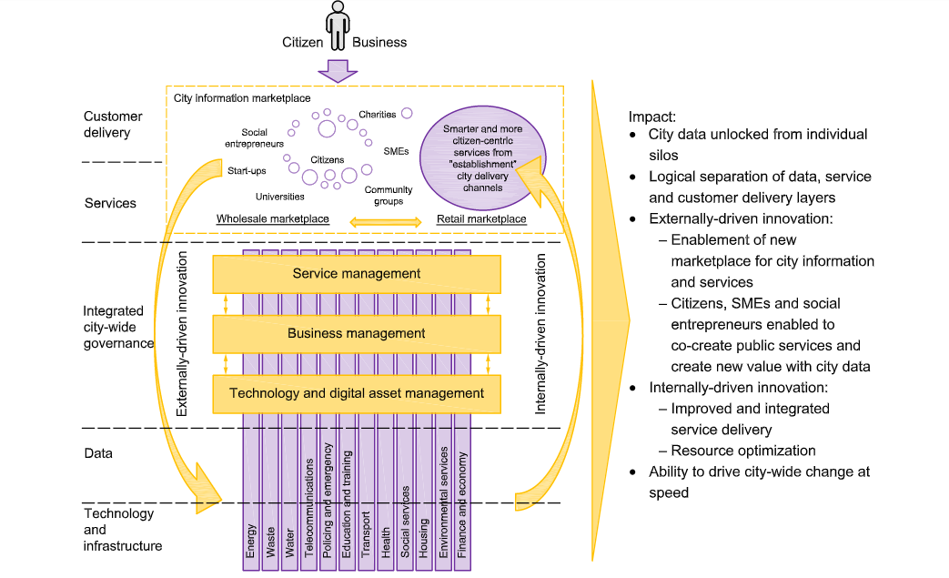
PAS 181 – Transforming smart cities to …

Slide 13
Technical standards – Implementing Smart cities projects
ISO/IEC AWI 30145 Information technology – Smart city ICT reference framework
ISO/IEC AWI 30146 Information technology – Smart city ICT indicators
IEEE P2413 (http://standards.ieee.org/develop/project/2413.html) is a developing standard for an architectural framework for the Internet of Things (IoT) and many more…
SmartStatistics4SmartCities

Slide 14
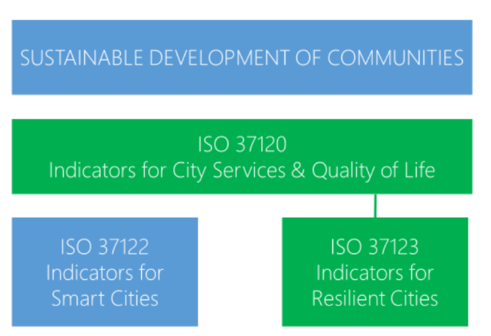
Family of City Indicators Standards
ISO 37101
SmartStatistics4SmartCities

Slide 15
ISO 37101:2016
Sustainable development in communities — Management system for sustainable development
SmartStatistics4SmartCities

Slide 16
ISO 37101:2016 objectives
Successful implementation of this International Standard can:
help to build consensus on sustainable development within communities;
improve the sustainability, smartness and resilience of strategies, programmes, projects, plans and services conducted under the direct responsibility of communities, or on the territory they relate to;
evolve cross-sector, multidisciplinary, life cycle value and total costing approaches;
foster synergies between several actors through a holistic approach;
increase the efficiency and attractiveness of communities.
SmartStatistics4SmartCities

Slide 17
ISO 37101:2016 Model
This International Standard is based on the Plan-Do-Check-Act (PDCA) model, which can be briefly described as follows:
Plan: establish objectives and processes necessary to deliver results in accordance with community purposes;
Do: implement processes and achieve objectives;
Check: monitor and measure processes against community policy, objectives and commitments, and report the results;
Act: take necessary actions to improve performance.
SmartStatistics4SmartCities

Slide 18
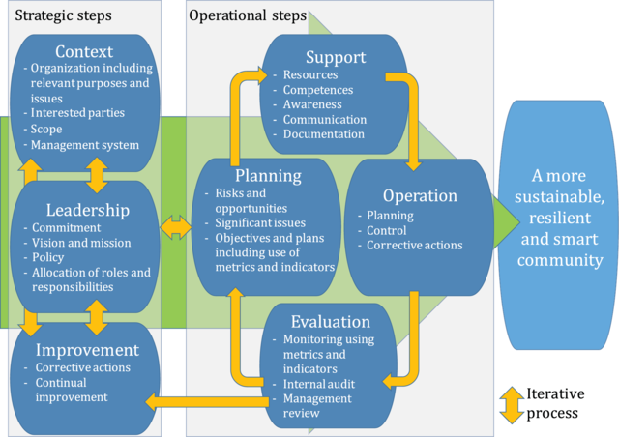
Relationship between PDCA model and ISO 37101:2016
SmartStatistics4SmartCities

Slide 19
ISO 37120:2014 Sustainable development of communities ISO 37120:2018 Sustainable cities and communities - Indicators for city services and quality of life
SmartStatistics4SmartCities

Slide 20
ISO 37120:2018 Indicators across 19 themes
Economy
Education
Energy
Environment and climate change
Finance
Governance
Health
Housing
Population and social condition
Recreation
Safety
Solid waste
Sport and culture
Telecommunication
Transportation
Urban/local agriculture and food security
Urban planning
Water and wastewater
SmartStatistics4SmartCities

Slide 21
ISO 37120:2018 Indicators structure
Core indicators: demonstrate performance in the delivery of city services and quality of life.
Supporting indicators: demonstrate performance in the delivery of city services and quality of life. Selected according to city objectives.
Profile indicators: indicators that are recommended to provide basic statistics and background information to help cities determine which cities are of interest for peer comparisons.
SmartStatistics4SmartCities

Slide 22
ISO 37120:2018 Indicators’ selection criteria
The list of indicators is based on the following criteria:
Completeness: indicators have to measure all relevant aspects for evaluation of the smart city.
Technology neutral: not favouring one technology over another, existing or future.
Simplicity: indicators can be expressed and presented in an understandable and clear way.
Validity: indicators are an accurate reflection of the facts and data can be collected using scientific techniques.
Verifiable: indicators are verifiable and reproducible. Methodologies are rigorous enough to give certainty to the level of implementation of the criteria.
Availability: quality data is available or it is feasible to initiate a monitoring process that will make it available in the future.
SmartStatistics4SmartCities

Slide 23
ISO 37120 Indicators/1

Slide 24
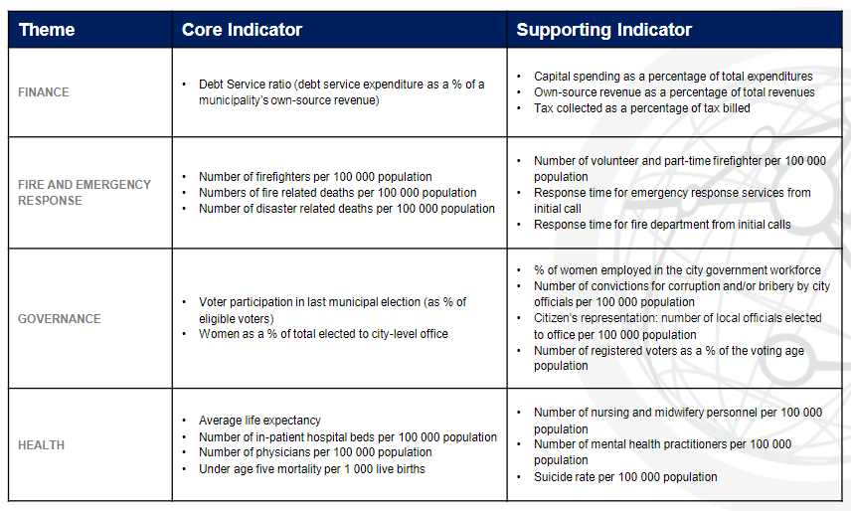
ISO 37120 Indicators/2

Slide 25
ISO 37120:2018 An example of an indicator
Theme
Economy
Core indicator
- City’s unemployment rate
Supporting indicators
- Assessed value of commercial and industrial properties
- Percentage of persons in full-time employment
- Youth unemployment rate
A city’s unemployment rate shall be calculated as the number of working-age primary residents who during the survey reference period were not in paid employment or self-employment, but available for work and seeking work (numerator) divided by the total labour force (denominator). The result shall be multiplied by 100 and expressed as a percentage.
SmartStatistics4SmartCities

Slide 26
Mapping of indicators to United Nations Sustainable Development Goals (SDGs)
SmartStatistics4SmartCities

Slide 27
Data for cities (ISO 37120) http://www.dataforcities.org/
SmartStatistics4SmartCities

Slide 28
SmartStatistics4SmartCities

Slide 29
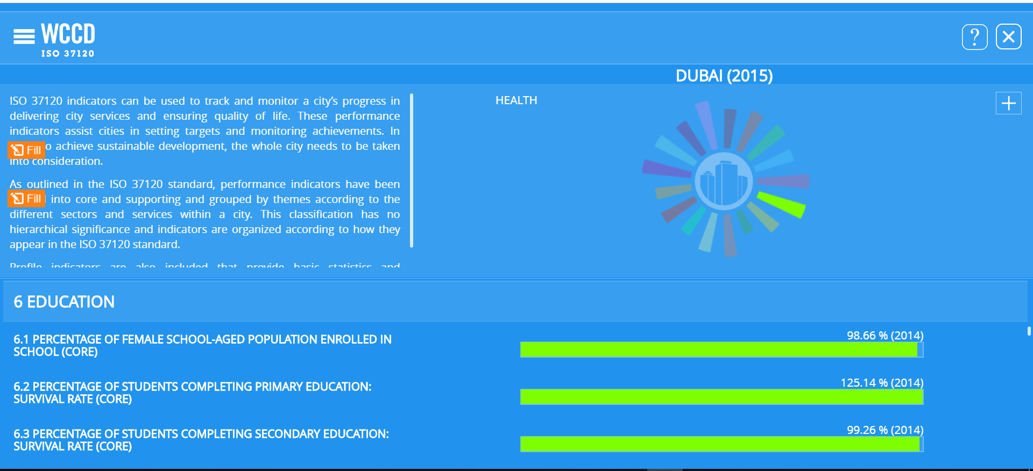
World Council on City data – Dubai → Education
SmartStatistics4SmartCities

Slide 30
ISO 37123
Indicators for resilient cities
SmartStatistics4SmartCities

Slide 31
Definition of resilient city
A Resilient City is a city that is able to manage, adapt, maintain and ensure city services and enhance quality of life in the face of hazards, shocks and stresses.
This includes the capacity to resist, absorb, accommodate, adapt to, transform, and recover from the effects of hazards and disasters in a timely and efficient manner, including through the preservation and
restoration of essential basic structures and services in a sustainable way, and through risk management practices.
SmartStatistics4SmartCities

Slide 32
An example from ISO 37123 on safety indicators
Percentage of population covered by multi-hazard early warning system
Remember that disaster at Mati, Athens this year was mainly a failure of this time
100 people died.
Percentage of emergency responders that have received disaster response training to manage worst case scenarios Percentage of emergency responders able to communicate during a disaster event via professional mode radio, satellite telephony, or privileged-access mobile communication networks
Percentage of local hazard warnings or forecasts issued by national agencies that are received in timely fashion by city emergency responders
Number of health and educational facilities destroyed or damaged by natural hazards per 100 000 population
SmartStatistics4SmartCities

Slide 33
Percentage of population covered by multi-hazard early warning system
This indicator refers to the specific warning of an imminent threat. Early warnings of that threat are essential to reduce human and economic losses from disasters. Warning systems prevent loss of life and mitigate the economic and material impacts of disasters.
It is the responsibility of municipal governments to ensure that its citizens are effectively covered by some form of early warning system, enabling better preparedness for (and response to) disaster events. Warnings should be reliable and specific to the hazard threats of a city, and should allow ample time for preparation and response (as far as technology permits).
SmartStatistics4SmartCities

Slide 34
In Greece
ELOT developed ELOT 1457 standard
Currently under consultation (18/10/2018)
ELOT 1457 defines indicators for
Sustainable and Smart Cities
Specific ICT indicators
Indicators are aligned with Sustainable Development Goals of UN.
Available for download at http://www.elot.gr/1427_ELL_HTML.aspx
SmartStatistics4SmartCities

Slide 35
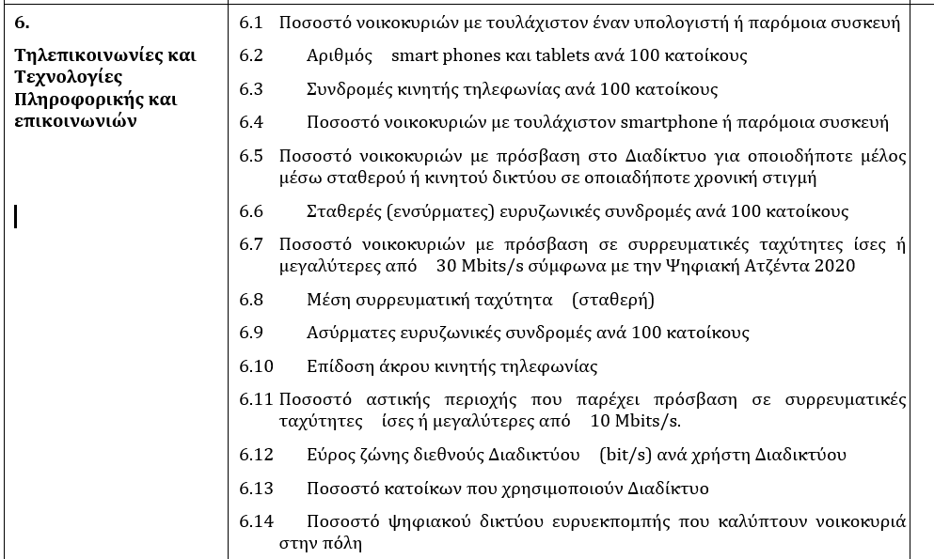
ELOT 1457 - Sample

Slide 36
Conclusions: Implementation of Smart and Sustainable cities requires
Vision
Long term plan
Setting long term objectives
Strategy
Realistic objectives
Leadership
Committing to objectives
Securing funding
Prioritization
Implementation
Collaboration between stakeholders
Management skills
Standarization
Use of best practices

Slide 37
Thank you for your attention
Panos Fitsilis
pfitsilis@gmail.com

